Slide 1
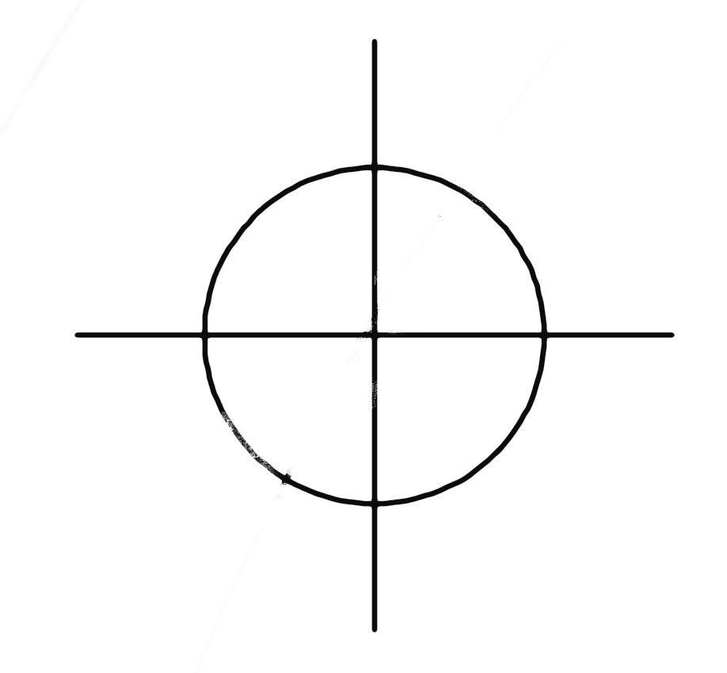
Brainstorming tool to expand privacy-centric use-cases
Mykola Siusko
V 1..0, dec 2022

Slide 2
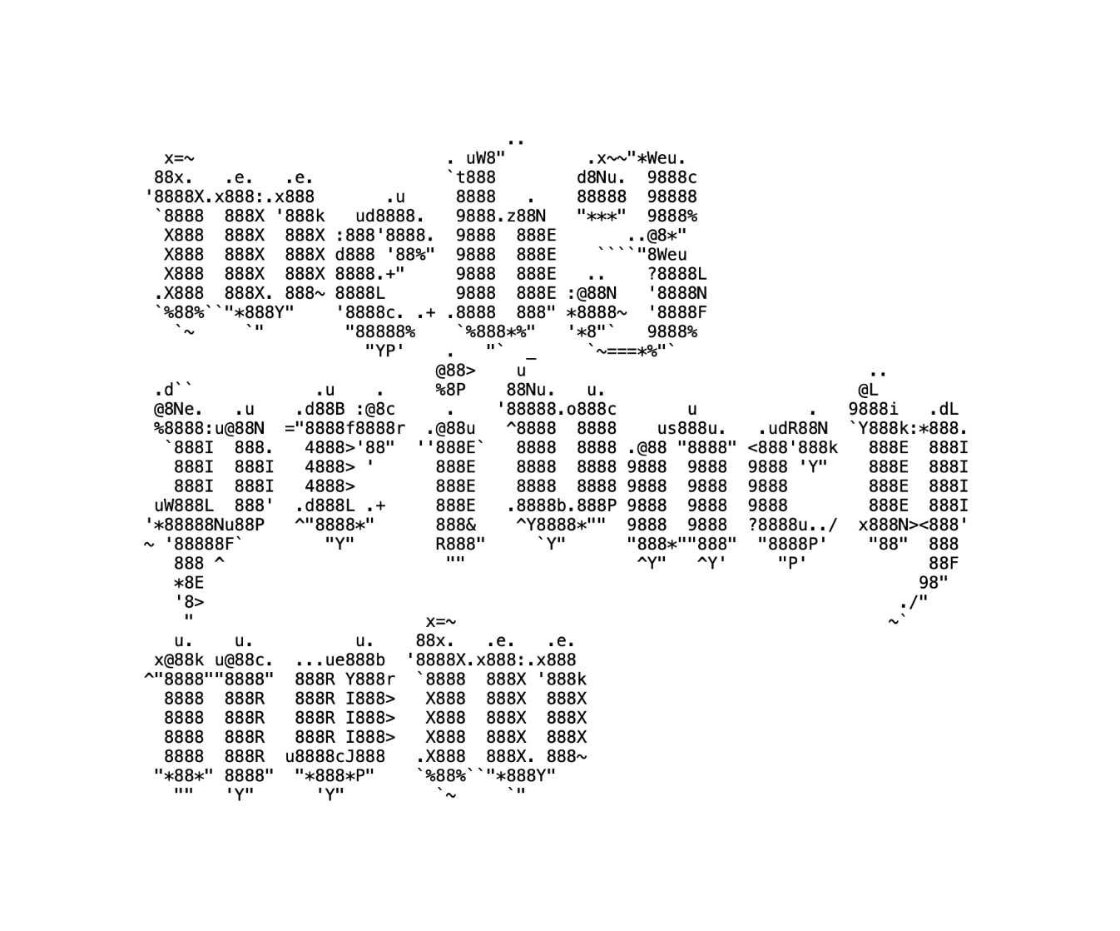
WHAT IF… THEY WON’T HAVE MY DATA
Data
Threat actor
Privacy benefits
With data
Without data
Decentralisation

Slide 3
WHAT IF… THEY WON’T HAVE MY DATA
Data
Threat actor
Privacy benefits
Internet: age, geo, IP address, internet traffic (from photos to messages), online contacts, loyalty programs participation, purchases, advertising performance, behaviour Offline: geo, historical mobility data, favourite places, face, participation in political activities, mobile traffic, phone calls
Corporations (Surveillance capitalism) - FMCG: Coca-Cola, Nike - Big Tech: Google, Meta
FMCG - Allocate budgets to non-intrusive community building - Make products that lasts - Decrease product-centric pollution - Care about relations & not just annual sales
Big Tech - Redesign business model (non-ad, subscription, value based) - Make products that care about your emotional state (switch off when it’s “too much”) - Promote healthy speech instead of hate speech - Connect people via meaningful brands (truly sustainable, ethical - Advertising tools are accessible to small brands - Embrace data ethics & regulators compliance
New social media appears!
Data available
Data unavailable
100% consent-centric & non-cheating approach to data usage
Can’t sell more & more advertisements
Can’t alter attention, emotions, friends & relations
Can’t drive hate, fear & uncertainty
Can’t fuel genocide
Can’t sell more fast
Surveil 24/7 both online & offline
Trade your personal data
Produce impactful advertisement
Create attention altering products
Drive negative emotions for long-lasting product usage
Produce “eternal scroll” effect
Pollute online-landscape with advertising
Accelerate consumerist lifestyle
Disrupt “friendship”, “like”, “community” phenomenas
Decentralisation

